Slide 1
Voice Recoginition
Members: Sixiang Zhang, Shaoxiang Zeng
Advisor: Dr.Hsu
CIS 598 - Senior Project

Slide 2
Index
Schedule and Current Progress
Updates&Chenges of Requirement
Develop Environment
App structure, design & problem
Api based App Demo - if possible

Slide 3
Schedule & Progress
Complete basic functions of API based App (√ 3/5/2020)
A prototype console App based on Google Speech Recognition API (√ 3/10/2020)
Able to train a model with dataset with DeepSpeech2 / Baidu Self-trainning platform(√ 3/17/2020)
Research & Try to apply AI model to our program (current task)
Apply model & AI based App complete (March & April)
Prepare for final presentation(April & May)

Slide 4
Updates&Chenges of Requirement
Develop Environment
API baseed App - Windows:
Library: SpeechRecognition
AI based App - Ubuntu 18.04:
Hardware: GTX1050 (Notebook)
Library & Tool: tensorflow-gpu, Anaconda, Baidu Self Tranning Platform, DeepSpeech2
Required Parts: GPU Support - NVDIA driver 430.5, CUDA 10.1,
Neural Network Support - cuDNN 7.65
IDE: Pycharm
Code: Python2.7
Common Libirary (used for both): Pydub, ffmpeg

Slide 5
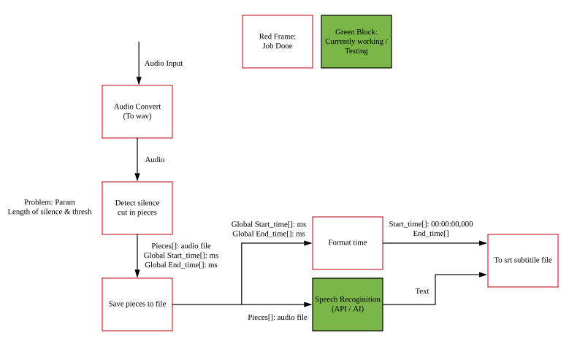
App structure, design & problem

Slide 6
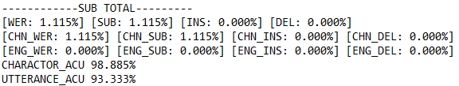
App structure, design & problem
We are going to have a training model of our voice to text project which will ask user to input a voice file and output the text of the source file.
Currentlay working on find training model which can use with big training set.
testing result of Baidu’s AI self-training platform

Slide 7
App structure, design & problem
Problem:
1. Find and choose a effective frame of training model. (DeepSpeech2, Baidu’s AI self-training platform)
2. Training data set. (LibriSpeech from openSLR)
(1,2 solved by 3/17/2020, but still can be potential problems)
3. Training may take lots of time (Maybe few days, or longer)
4. Apply model to our program
5. Further development. (Type of source files, streaming subtitle…)

Slide 8
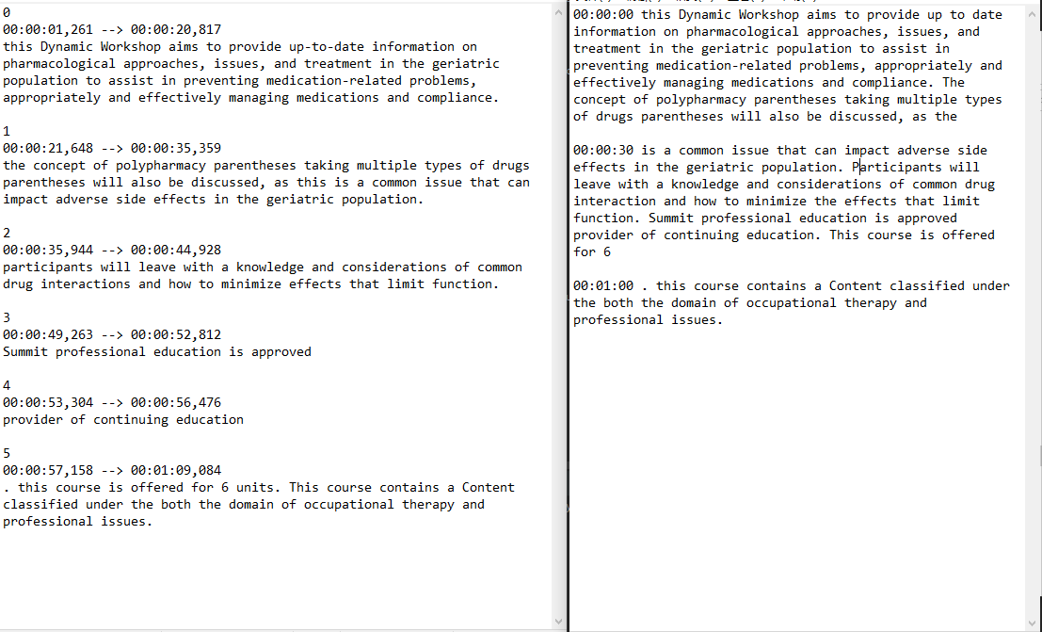
API Based APP Demo - if possible
Left: out put of App
Right: Original correct text

